Slide 2
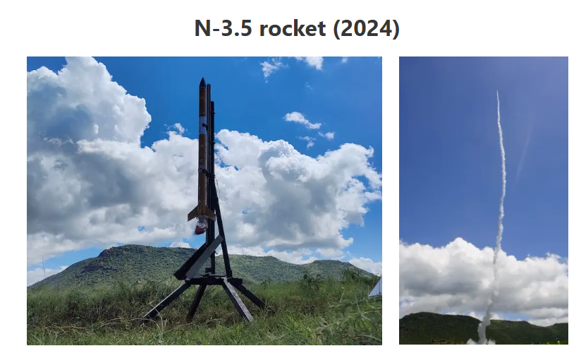
Presentation Outline
Problem Statement
Objectives
Key Literature Review
Proposed Methodology
(Mechanical & Electrical)
Expected Outcomes
Project Time Plan
Budget
Notes:
3/2/2026
1

Slide 3
Problem Statement
Limited Telemetry Range
Current telemetry protocol suffers rapid RSSI decay
Unreliable Deployment Ignition
DC dump ignition of nichrome wire exceeds 1000 °C
single-use deployment system
No Pre-Flight Health Feedback
No real-time battery voltage monitoring

Slide 4
Objectives
Main Objective: To design and fabricate a reliable dual recovery system for the N4 rocket with extended telemetry range.
Specific Objectives:
Extended-Range Telemetry: Implement Digi XBee-PRO 900HP for reliable >5 km communication with <5% packet loss.
Controlled Pyrotechnic Deployment: PWM-regulated nichrome ignition with sealed explosion caps for reliable drogue and main deployment.
Integrated Avionics & Health Monitoring: Rugged 3D-printed PETG avionics holder with vibration isolation, battery retention, and real-time system diagnostics.
System Validation: Pop tests for deployment reliability and range tests confirming >5 km telemetry performance.

Slide 5
Literature Review: Telemetry
Category / Author | Title / Context | Key Results | Gaps (Addressed by N4)
Nakuja N4 Team (2024) | Range Test 2: RSSI Analysis | 2.4 GHz signals degraded rapidly with distance/altitude ¹¹¹¹ | Range Limit: Current beacons suffer signal loss at <2 km
Chen L., Kumar R. (2022) | PWM control for ignition | PWM allows precise temperature regulation of nichrome | Reusability: DC dump melts wires instantly (single-use)
Nakuja N4 Team (2024) | Post-Deployment Analysis | Ejection worked but caused internal charring and damage | Containment: Lack of sealed caps led to unpredictable pressurization ¹⁴
Nakuja N4 Team. (2025) | Battery management systems | Unpredictable draw of power from the battery pack | Safety: Lack of a proper battery management results in battery damage

Slide 6
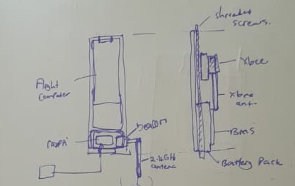
Methodology
Design Considerations
A. Operational Limits (Flight Profile)
Target Apogee: ~3.6 km
Max Telemetry Range: 5.0 km+ (Calculated link margin of +32.34 dB)²²².
B. Electrical Requirements
Nominal Voltage: 14.8V (4S Configuration)⁴.
Safety Threshold: Launch inhibit programmed at 14.0V⁵.
C. Mechanical & CAD Dimensions
Avionics Sled Height: 222.00 mm.
Sled Width: 95.20 mm.
Battery Standard (IREC/SA Cup): Lithium Ion 18650 cells. 18.6 mm (Max Diameter) x 65.2 mm (Max Length)
Proposed Full Assembly Design

Slide 7
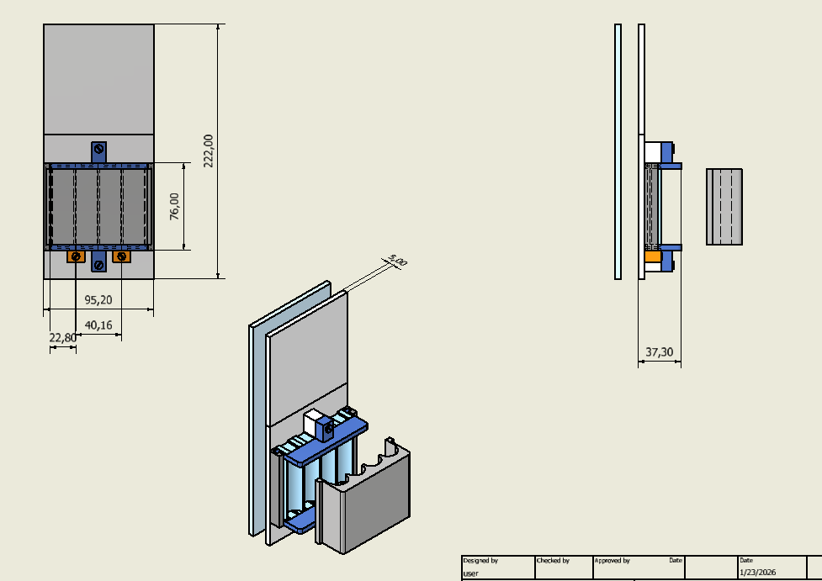
Methodology
Focus: Solving the vibration and power failure issues (The CAD).
Custom Avionics Sled (CAD Design):
Material: 3D-printed PETG for high impact resistance.
Battery Retention:
Replaces standard spring-loaded holders which fail under high-G force.
Uses a constrained slot design (95.20mm x 40.16mm footprint) to mechanically lock the battery pack in place.
Vibration Isolation:
PCB mounted on Brass columns for easy removal of the Flight Computer for data retrieval.
CAD Design Using inventor

Slide 8
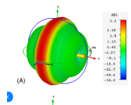
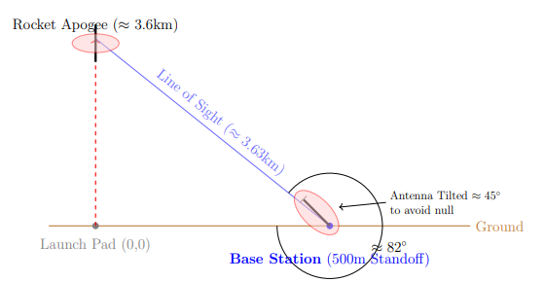
Methodology
Xbee
Focus: Why 5km is possible (The Link Budget).
Telemetry Range Justification:
Hardware: Digi XBee-PRO 900HP (S3B) antenna at +24 dBm transmission power¹.
Link Budget: Calculated Free Space Path Loss (FSPL) at <5km is approx 105.66 dB².
Safety Margin: Theoretical link margin of +32.34 dB allows for range significantly >5km under ideal conditions³.
Signal Reliability Strategy:
The "Donut" Effect: Vertical dipole antennas have "nulls" (blind spots) directly overhead⁴.
Mitigation: Ground station antenna will be tilted 45° to align the radiation lobe with the rocket at apogee⁵⁵⁵⁵.
Fig shows Donut shape of the duck antenna signal
Proposed Antenna Orientation

Slide 9
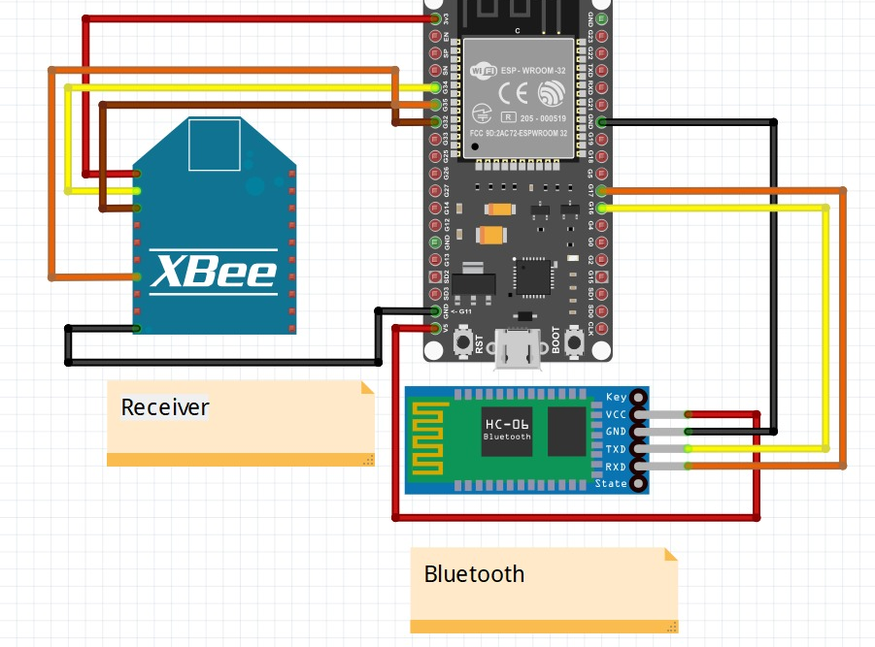
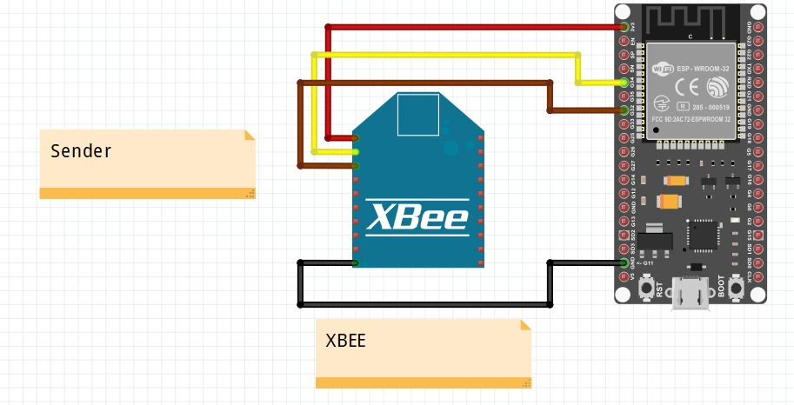
Methodolgy
Electrical
Circuit Topology:
Sender (Rocket): ESP32 wired to XBee via UART (Pins 32/34) with voltage regulation.
Receiver (Ground): ESP connected to HC-06 Bluetooth module for wireless forwarding to mobile devices/laptops.
Ignition Logic:
PWM Control: MOSFET drivers use Pulse Width Modulation to regulate current, preventing "instant melt" of Nichrome wire.
Safety Interlock: Software prevents ignition if battery voltage drops below safe threshold (<14V).
Proposed Sender and receiver Circuit connections

Slide 10
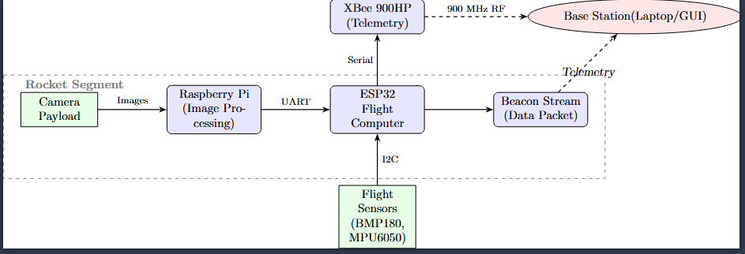
Methodology
Software and Data Archtecure
Proposed Data Flow architecture
To maximize mission reliability and data throughput, the software architecture employs a Dual-Link Transmission Strategy. Instead of relying on a single point of failure, the system separates critical flight data from high-bandwidth payload data, effectively utilizing both the XBee 900HP and the legacy Beacon systems.

Slide 11
Pending Tasks
Here are the ending tasks as per the project proposal is concerned.
Design circuits for etching using easyEDA.
Design the Battery and chute monitoring sustems.
Optimise the present explosion cap
Static analysis of Esplosion CAP and the FC holder

Slide 12
Expected Outcomes
Operational Reliability:
Telemetry: Continuous data stream up to 5 km altitude with <5% packet loss using XBee-PRO 900HP.
Safe Recovery: Successful parachute deployment with zero thermal damage to the canopy, achieved via the Sealed Explosion Cap and PWM Ignition.
System Integrity:
Electronics: A custom-fabricated PCB that eliminates wire fatigue and ensures reliable connections under vibration.
Mechanical: A vibration-proof, 3D-printed avionics holder that maintains Center of Gravity (CG) stability.
User Feedback (Ground Station):
Real-time monitoring of Battery Voltage, Igniter Continuity, and GPS Position.
Automatic "Launch Inhibit" safety protocol if main battery voltage drops below 14.0V.

Slide 13
Budget
Budget
Item | Description |  | Cost (KES) | Total (KES)
Telemetry Modules* | Digi XBee-PRO 900HP (Long Range) | 2 | 15,000 | 30,000
Antennas | 900MHz High Gain Antenna | 2 | 2,000 | 4,000
Copper Cladding | PCB Board (15 x 20 cm) | 3 | 200 | 600
Microcontroller | ESP32 Development Board | 1 | 1,800 | 1,800
Sensors | BMP180 + MPU6050 Module | 1 | 4,710 | 4,710
Mosfets | IRLZ44N (Pack of 5) | 1 | 1,000 | 1,000
Pyrotechnics* | Black/Crimson Powder | 1 | 1,600 | 1,600
Mechanical Parts* | Threaded Rods & Hardware | 1 | 1,000 | 1,000
Filament | PLA (1kg Roll) | 1 | 3,000 | 3,000
Batteries | Lithium-Ion Cells (18650) | 4 | 500 | 2,000
Total (With Purchased) |  |  |  | 49,710
Total (Without Purchased) |  |  |  | 13,110
Items with * Are already Purchased

Slide 14
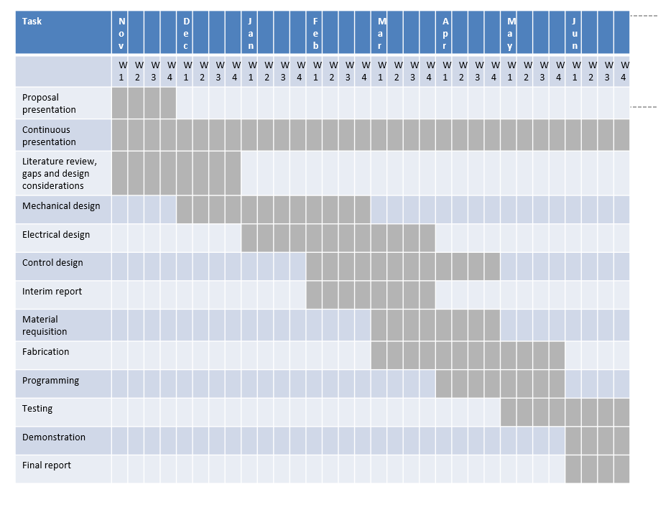
Timeplan
Time plan

Slide 15
Thank you for your attention.

